Slide 1
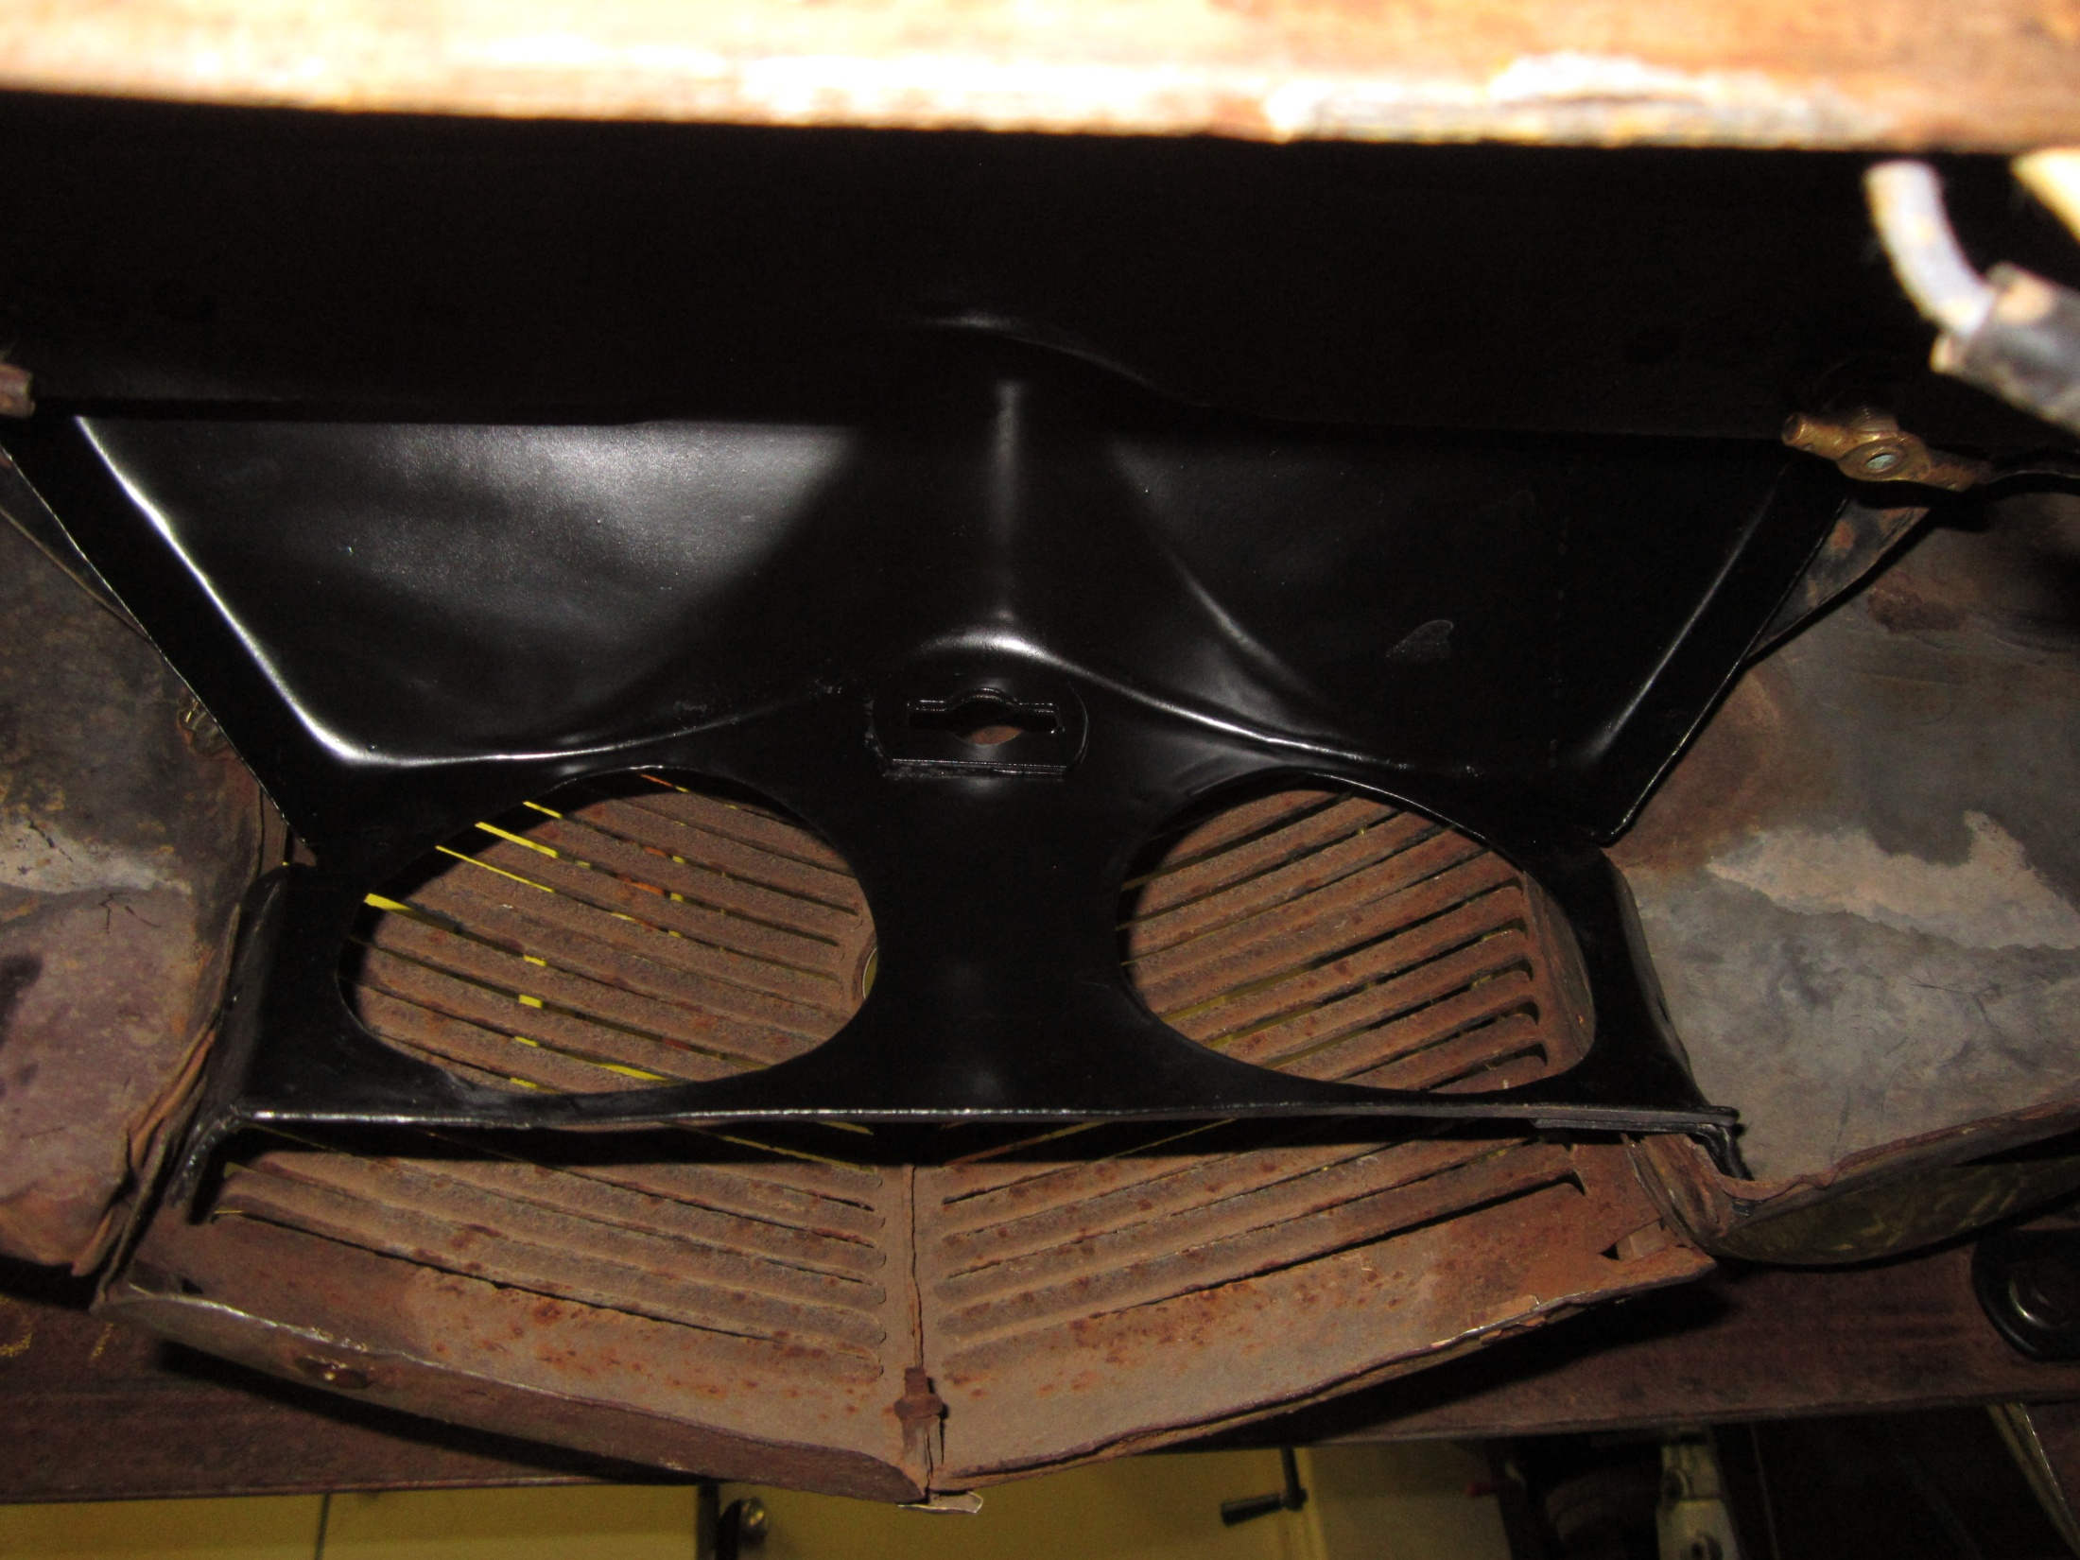
Is this a 37 part? Does it mount inside or outside of the grille/fender assembly?

